Slide 1
SUB GRAPHS

Slide 2
Definition:
A Subgraph of a graph is a graph whose vertex set is a subset of the vertex set , that is , and whose edge set is a subset of the edge set , that is .
Essentially, a subgraph is a graph within a larger graph.

Slide 3
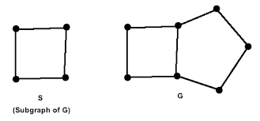

Slide 4

All the edges and vertices of G might not be present in S; but if a vertex is present in S, it has a corresponding vertex in G and any edge that connects two vertices in S will also connect the corresponding vertices in G. All of these graphs are subgraphs of the first graph.

Slide 5
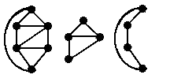
A vertex-induced subgraph is one that consists of some of the vertices of the original graph and all of the edges that connect them in the original. An edge-induced subgraph consists of some of the edges of the original graph and the vertices that are at their endpoints.
The second two figures are vertex-induced subgraphs of the first figure.

Slide 6
The second two figures are vertex-induced subgraphs of the first figure.

Slide 7
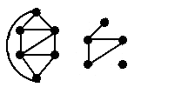
The second figure is a subgraph of the first figure,
but it is neither edge-induced nor vertex-induced.

Slide 8
A spanning subgraph is a subgraph that contains all the vertices of the original
graph. A spanning tree is a spanning subgraph that is often of interest.
A cycle in a graph that contains all the vertices of the graph would be called a
spanning cycle. However it's more common name is a Hamiltonian cycle.

Slide 9
BALANCED BINARY SEARCH TREE

Slide 10
A self-balancing (or height-balanced) binary search tree is any node-based binary search tree that automatically keeps its height (maximal number of levels below the root) small in the face of arbitrary item insertions and deletions.^{[1]}
These structures provide efficient implementations for mutable ordered lists, and can be used for other abstract data structures such as associative arrays, priority queues and sets.
The red–black tree, which is a type of self-balancing binary search tree, was called symmetric binary B-tree^{[2]} and was renamed but can still be confused with the generic concept of self-balancing binary search tree because of the initials.

Slide 11
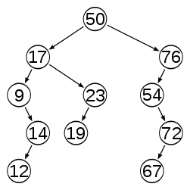
An example of an unbalanced tree;
following the path from the root to a node takes an average of 3.27 node accesses

Slide 12
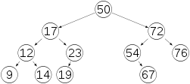
The same tree after being height-balanced; the average path effort decreased
to 3.00 node accesses

Slide 13
Self-balancing binary search trees can be used in a natural way to construct and
maintain ordered lists, such as priority queues.
They can also be used for associative arrays; key-value pairs are simply inserted with
an ordering based on the key alone.
One advantage of self-balancing BSTs is that they allow fast (indeed, asymptotically
optimal) enumeration of the items in key order, which hash tables do not provide.
One disadvantage is that their lookup algorithms get more complicated when
there may be multiple items with the same key.

Slide 14
Self-balancing BSTs are flexible data structures, in that it's easy to
extend them to efficiently record additional information or perform new
operations.
For example, one can record the number of nodes in each subtree
having a certain property, allowing one to count the number of nodes in a certain
key range with that property in O(log n) time.
These extensions can be used, for example,
to optimize database queries or other list-processing algorithms.

Slide 15
Thank You

